Slide 1
MULTI LINKED LIST AND SPARSE MATRIX

Slide 2
MULTI LINKED LIST
In multi linked list each node can have any number of pointers pointing to other nodes.
Multi linked list is the process of embedding multiple linked list into one data structure.
In multi linked list, each node has more than one pointer like doubly but these pointers points to separate linked lists.

Slide 3
EXAMPLE 1: LIST OF LISTS
Suppose we want to make a list of departments of an university Ex. CSE, ECE, IT, Management etc.
Each department run various streams like B. Tech. and M. Tech.
Each stream has multiple number of semester. For eg. In B. Tech stream there are 8 semesters and in M. Tech. there are 4 semesters.
In each semester there are number of courses.

Slide 4
CSE
Management
ECE
NULL
B. Tech
I Sem
C1.1
C1.2
C1.n
NULL
II Sem
C2.1
C2.2
C1.m
NULL
M. Tech
NULL
III Sem
I Sem
IV Sem
II Sem
V Sem
III Sem
VI Sem
IV Sem
NULL
VI Sem
VI Sem
NULL
C8.1
C8.2
C8.x
NULL

Slide 5
STRUCTURE OF NODES
So How many Structures we need to define in order to implement the addressed problem.

Slide 6
STRUCTURE OF NODES
So How many Structures we need to define in order to implement the addressed problem.
Course
Semester
Stream
Department

Slide 7
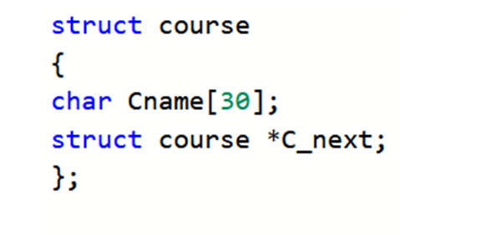
STRUCTURE OF NODES

Slide 8
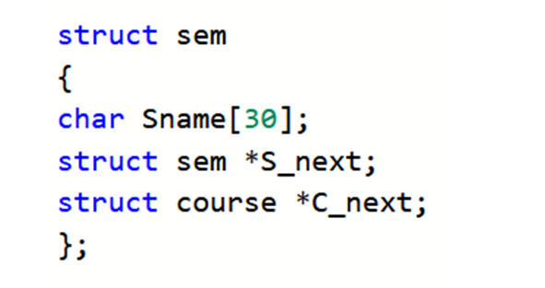
STRUCTURE OF NODES

Slide 9
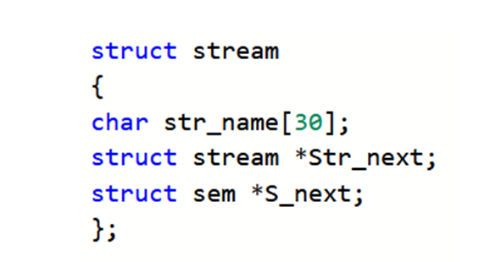
STRUCTURE OF NODES

Slide 10
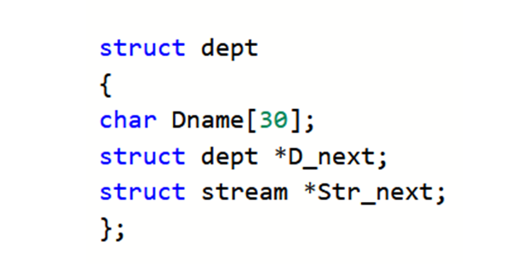
STRUCTURE OF NODES

Slide 11
FUNCTION TO DISPLAY THE COURSES OF B.TECH ECE 8TH SEMESTER

Slide 12
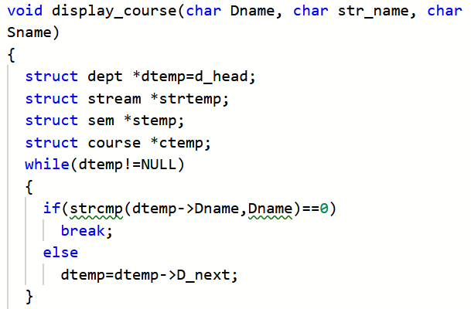
FUNCTION TO DISPLAY THE COURSES OF B.TECH ECE 8TH SEMESTER

Slide 13
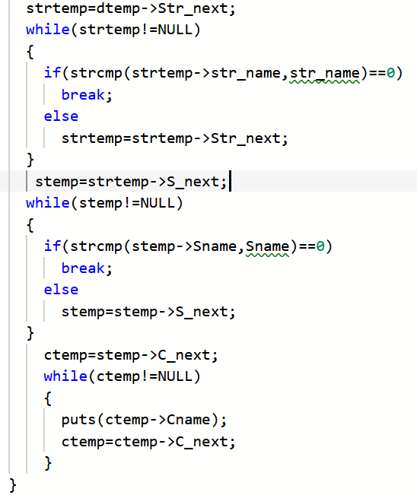

Slide 14
EXAMPLE 2: SPARSE MATRIX
Sparse matrix is a matrix in which maximum elements contain zero value.
If almost all elements contain zero in array of 1000X1000 elements then we can store only nonzero elements in a linked list with their rows and column.
Linked list representation of sparse matrix saves a lot of memory space.
0 | 0 | 0 | 0 | 1
0 | 0 | 0 | 1 | 0
0 | 0 | 1 | 0 | 0
0 | 1 | 0 | 0 | 0
1 | 0 | 0 | 0 | 0

Slide 15
MULTI LINKED LIST REPRESENTATION OF SPARSE MATRIX
This representation uses two linked list.
First list contains value of row number and two pointers, one points to next node and other pointer points to non zero elements in that row.
Second list contains column number, value in that position and pointer to next node.
1
3
2
5
3
NULL
0 | 0 | 2 | 0 | 3
0 | 0 | 4 | 0 | 0
0 | 0 | 0 | 0 | 0
0 | 1 | 5 | 0 | 0
0 | 0 | 0 | 0 | 4
2
3
4
NULL
3
NULL
4
2
1
3
5
NULL
5
5
4
NULL

Slide 16
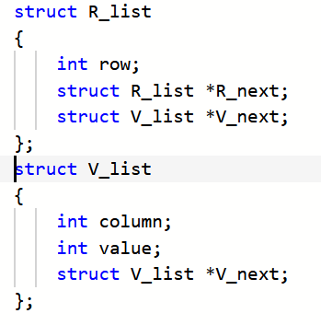
REPRESENTATION OF NODES

Slide 17
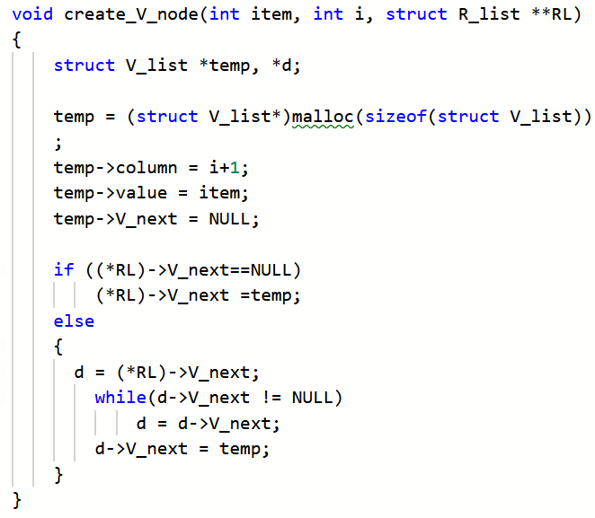
FUNCTION TO CREATE VALUE NODE (NODE OF SECOND LIST)

Slide 18
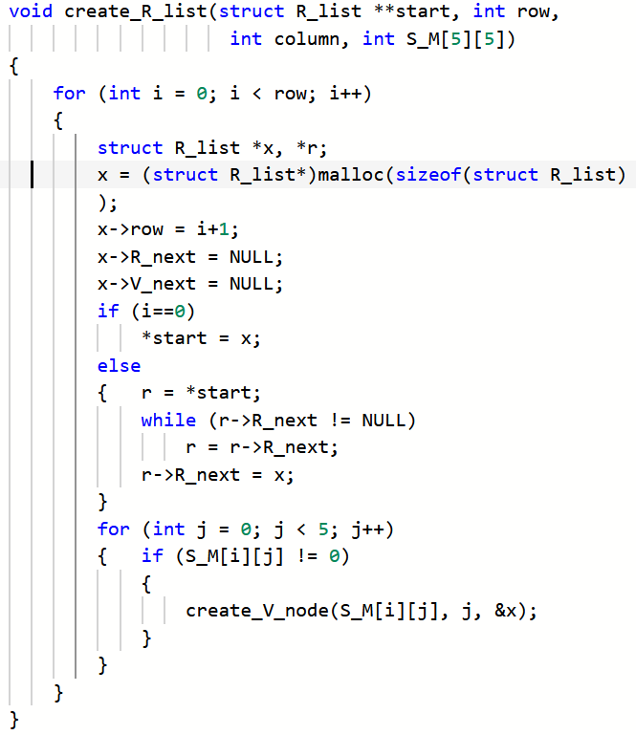
FUNCTION TO CREATE ROW NODE (NODE OF FIRST LIST)

Slide 19
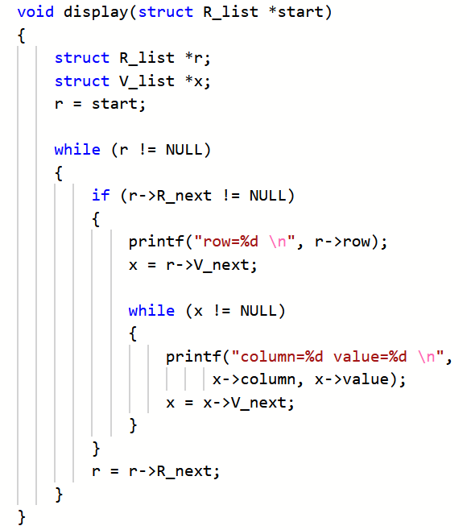
FUNCTION TO DISPLAY THE NON ZERO VALUES OF SPARSE MATRIX

Slide 20
